Slide 1

CAPSTONE PROJECT
IBEX CORE VERIFICATION USING UVM
OPEN SOURCE 32-BIT RISC-V CPU CORE WRITTEN IN SYSTEMVERILOG
FILZA SHAHID

Slide 2
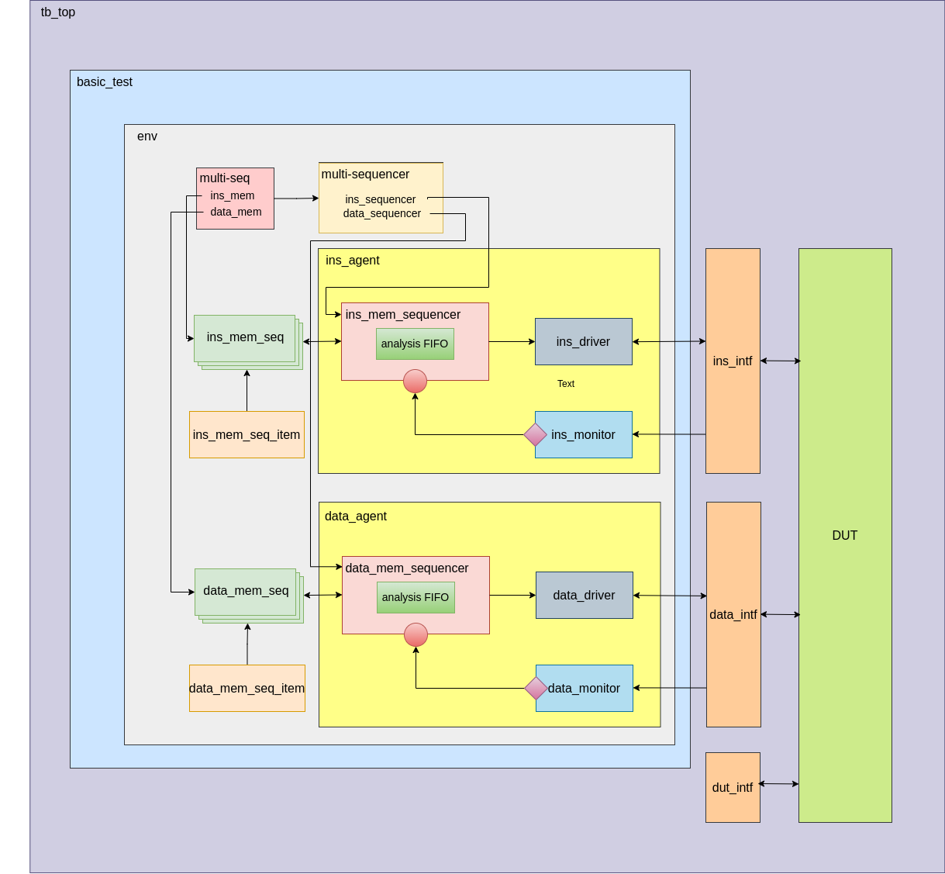
VERIFICATION
ARCHITECTURE
2 AGENTS:
INSTRUCTION FETCH
LOAD STORE
A VIRTUAL MULTI SEQUENCER IN ENV
3 INTERFACES

Slide 3
DESCRIPTION
1
Core starts execution when fetch signal is send to DUT by DUT Interface.
2
INS & DATA Monitors read the respective outputs coming from DUT through INS & DATA Interfaces.
3
These outputs are written to Analysis ports which are connected to analysis FIFO of the respective Sequencers.
4
INS & DATA Sequences gets the item from the FIFO export port of INS & DATA Sequencers.
5
INS & DATA Drivers get the respective Sequences from the INS & DATA Sequencers and drive them onto the Interfaces towards DUT.
6
Test terminates as soon as ECALL is detected by INS Interface signal and fetch signal of DUT Interface is disabled.

Slide 4
SANITY CHECKS
Simple Tests indicating correct working of verification environment
NOP ECALL
INITIALIZE REGISTERS
LOAD STORE

Slide 5
TEST CASES
R_TEST
I_TEST
JUMP
MIX_TEST
FACTORIAL
ARRAY

Slide 6
THANK YOU

